Slide 1


Slide 2
Project Presentation on - Role of Management Information Systems in a Mine.

Slide 3
OBJECTIVE:
TO MONITOR DIFFERENT UNIT OPERATIONS IN A MINE – DRILLING & BLASTING, LOADING , TRANSPORTATION,ETC. USING MANAGEMENT INFORMATION SYSTEMS.
SCOPE: OPTIMIZATION OF DIFFERENT UNIT OPERATIONS USING – MANAGEMENT INFORMATION SYSTEMS.

Slide 4
LITERATURE REVIEW: The Study of Management Information System for Coal Mine Safety Quality Standardization. - WANG Zhi-qianga, GAO Wei-ming. Management Control Information System of Mine Production and Operation Based on ERP/MES/PCS Three-Tiered Structure. - Xu Bo, Hu Nianlian, Li Yong Key Laboratory of the Ministry of Education of China for Efficient Mining and Safety of Metal Mines, University of Science and Technology Beijing, Beijing 100083, China. "Development of an MIS for Underground Metal Mines", Journal of Mines, Metals and Fuels, January-February, 1994, pp. 20-23 .K. Paul, K. Mukherjee and J.L. Chakrabarti. A management information system for mine railway transportation equipment- LI Mei-yu, HAN Ke-qi,ZHANG Xiao-yong, LI Xiao-lin, ZHAI Yong-jun, YU Wei-hu School of Mines, China University of Mining & Technology, Xuzhou, Jiangsu 221008, China

Slide 5
Introduction to MANAGEMENT INFORMATION SYSTEM ( MIS ):
A management information system (MIS) provides information needed to manage organizations efficiently and effectively. Management information systems involve three primary resources: people, technology, and information. Management information systems are distinct from other information systems in that they are used to analyze operational activities in the organization. Academically, the term is commonly used to refer to the group of information management methods tied to the automation or support of human decision making, e.g. decision support systems, expert systems, and executive information systems.

Slide 6
MIS is not new; only its computerization is new. Before computers, MIS techniques existed to supply managers with the information that would permit them to plan and control operations. The computer has added one or more dimensions, such as speed, accuracy, and increased volumes of data, that permit the consideration of more alternatives in a decision

Slide 7
Management information systems:
M-I-S
MANAGEMENT
INFORMATION
SYSTEM

Slide 8
1. management:
Management comprises the processes or activities that describe what managers do in the operation of their organisation ; plan, organize , initiate , and control operations.
Decision making is such a fundamental pre-requisite to each of the foregoing processes,
The job of an MIS becomes that of facilitating decisions necessary for planning, organizing, and controlling the work and functions of the business.

Slide 9
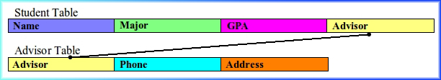
2. informations
Information consists of data that have been retrieved, processed, or otherwise used for informative or inference purposes , argument., or as a basis for forecasting or decision making. Types of informations or data:
RELATIONAL DATA
The relational data relates or connects data in different files through the use of a key field, or common data element.

Slide 10
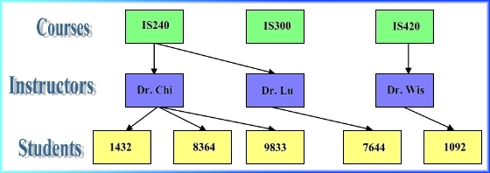
DATA TYPES CONTD……..
HEIRARCHIAL DATA:
In a hierarchical database, fields and records are arranged in a family tree, with lower-level records subordinate to higher-level records.

Slide 11
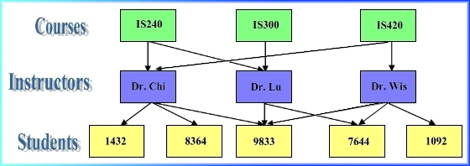
TYPES OF DATA CONTD….
NETWORK DATA:
A network database is similar to a hierarchical database except that each child can have more than one parent record.

Slide 12
3. SYSTEMS:
A system can be described simply as a set of elements joined together for a common objective. A subsystem is part of the larger systems. For our purposes the mining organisation is the system, and the parts ( divisions, departments, functions, units, etc.,) are the subsystems.
The systems concept of MIS is therefore one of optimizing the output of the organisation by connecting the operating sub-systems through the medium of information exchange.

Slide 13
Management in a mine:
A Mine manager is of the first type, i.e., operational management type.
The Strategic and the Tactical managerial roles are in the hands of the higher positions the organizational hierarchy.
Decision making can be regarded as an outcome of mental processes (cognitive process) leading to the selection of a course of action among several alternatives.

Slide 14
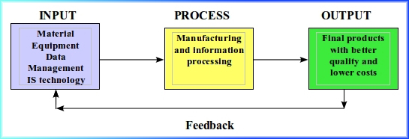
Mining as a manufacturing system:
Manufacturing is a broad and complicated subject. With minerals and metals manufactured, the processes and operations may be totally different.
The mission of a manufacturing information system is to apply computer technology to improve the information of the processes and the efficiency of a manufacturing system so that the quality of minerals is better and the costs to mine them are lower.
THE MODEL OF A MANUFACTURING INFORMATION SYSTEMS:

Slide 15
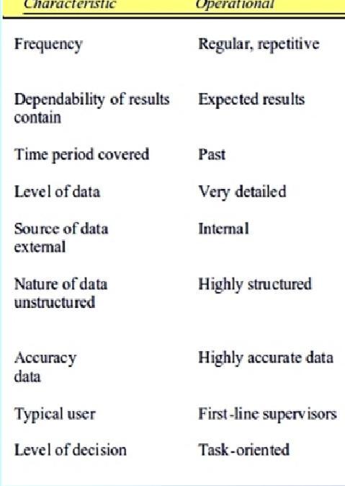
Mine management as operational management

Slide 16
The Line Manager of a mine has to process various information simultaneously at the same time and (i) Blast ID (ii) Blast Design & pattern (iii) Explosive Charging Sheet (iv) Blast Cost (v) Manpower and associated Cost (vi) Vibration Monitoring Data (vii) Accidents & Misfires (viii) Loading & Hauling Cycle Times., etc

Slide 17
Different approaches of MIS in Mining as a manufacturing organization:
In a Mine MIS requires a proper design to integrate the various aspects of Mining.
For this purpose the following types of Management Information Systems are generally used by the Mine manager for effective decision making :
Material Management System
Maintenance Information and Management System
Automatic Truck Dispatch System( TDS)
Mine Planning System ( eg. SURPAC , MINEX, VITTEL., etc.)
Computerized Weighing Operation System
Blasting Information Management System

Slide 18
VARIOUS SOFTWARES AVAILABLE IN TODAYS COMPUTERISED MANAGEMENT INFORMATION SYSTEMS ( CMIS ) AVAILALE FOR MINING INDUSTRY:
Blast Information Management System (BIMS)
Mine Management Reporting System (MMRS)
JKSimBlasT
Workforce Management Reporting System(WMRS)

Slide 19
1. Blast Information Management System (BIMS):
Blast Information Management Systems (BIMS) has been developed for storing, managing, and retrieving drilling and blasting related information to provide better control and optimization of mining operations.
Performance and Cost of Blasts can be monitored and stored in a manner convenient for both future and quick referencing
The system generates reports for individual blasts, monthly explosive consumption, stock , cost, vibration monitoring , and monthly blast.

Slide 20
.
BIMS has been developed to run on PC under Microsoft 98/2000/XP using Microsoft Access Database.
The use of Database allows an efficient way to manage and query the vast amount of information generated from the day to day blasting activities to meet the strategic and operational needs for the mines.
The program can be customized to link with the Organization’s own Management Information System.
The PC based database software is designed to be user friendly and require little training as such it is easy for mine personnel to use.

Slide 21
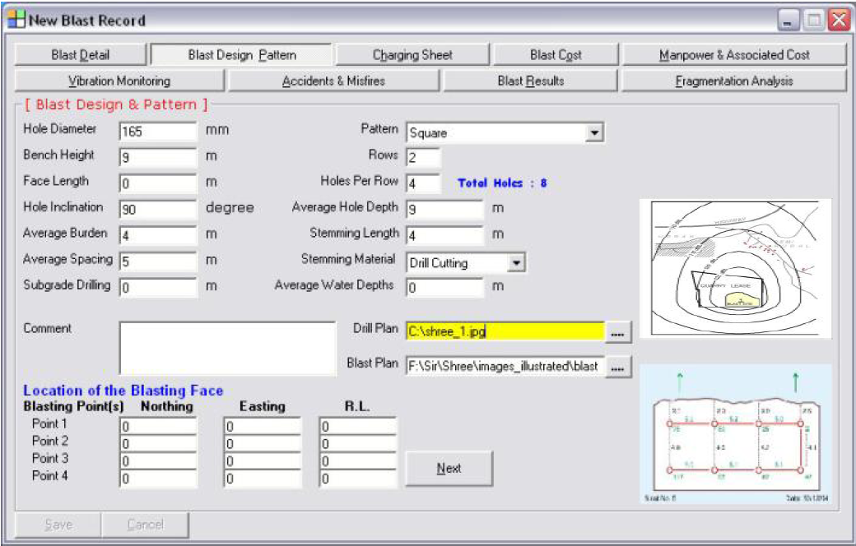

Slide 22
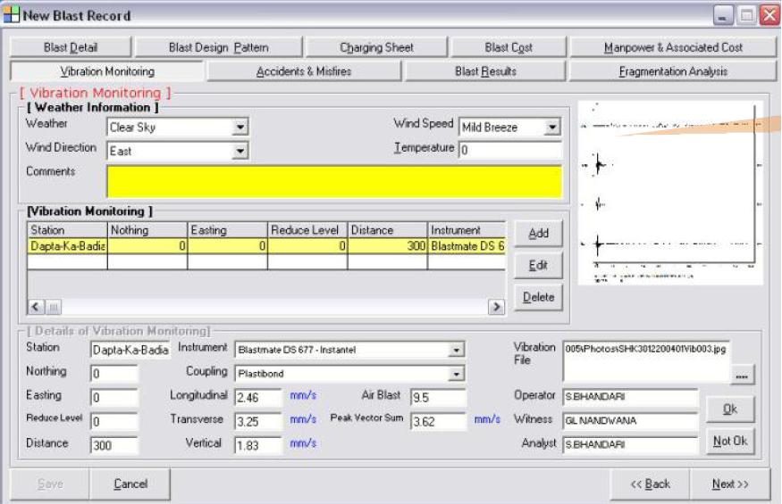

Slide 23
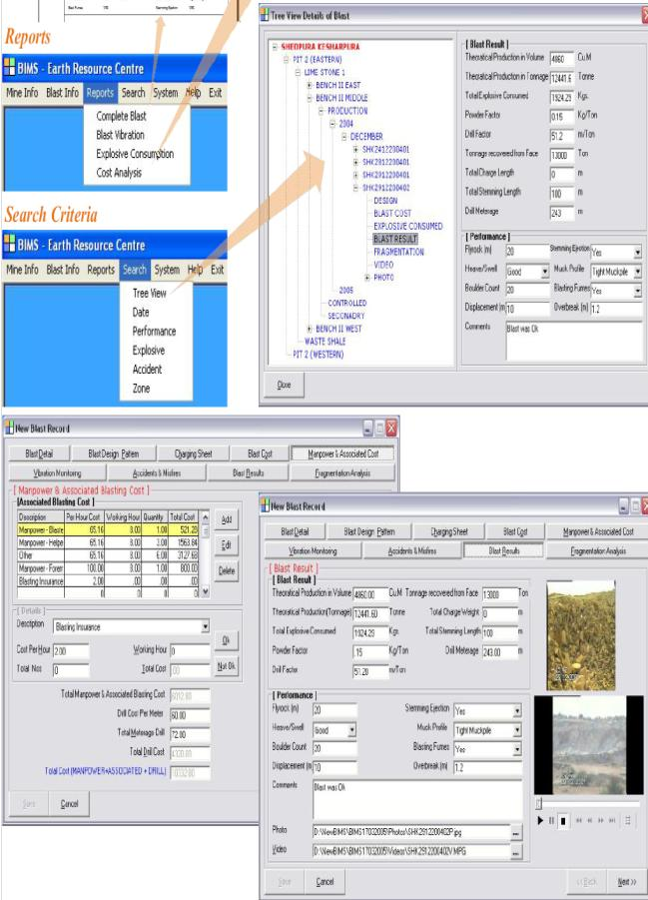

Slide 24

2. Mine Management Reporting System (MMRS):
MMRS is an advanced system for collecting, storing and reporting mine production and related information.
Covers most data types, processes and functions encountered in surface and underground mining.
Not constrained by the boundaries of location, time-zone, currency, units of measurement, commodity, mining method or time usage model.

Slide 25
MMRS covers many subject areas, including:
Production and production accounting
Ore tracking
Mobile equipment performance
Mobile equipment maintenance and health
Fixed plant performance
Fixed plant maintenance and health
Down time logging
Consumables
Mining cost estimation
Plans and budgets
Fuel management

Slide 26
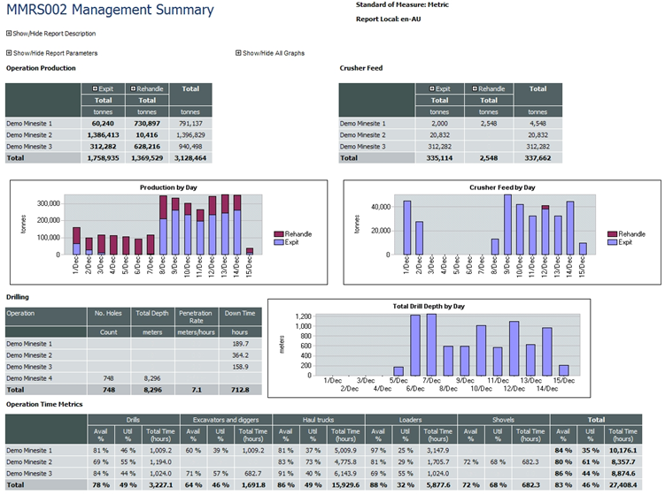

Slide 27

3.WORKFORCE MANAGEMENT REPORTING SYSTEM(WMRS):
To organize, store and retrieve information about the human resources employed throughout a mining organization.
Safe and low risk environment for employees and contractors.
WMRS is not designed to replace or duplicate any of the core benefits of a pre-existing Human Resources ERP system
To integrate with and enhance any existing human resources applications

Slide 28
WMRS is designed to cover key workforce management areas, including:
Safety and incident reporting
Safety KPI vs. target reporting
Hazard and Risk Management
Personnel, sub-contractor and visitor information
Environmental, community and security incident reporting
Action Management - assign and track actions
Personnel training, competencies and permits
Personnel scheduling
Site access and evacuations
Surveys & tests

Slide 29
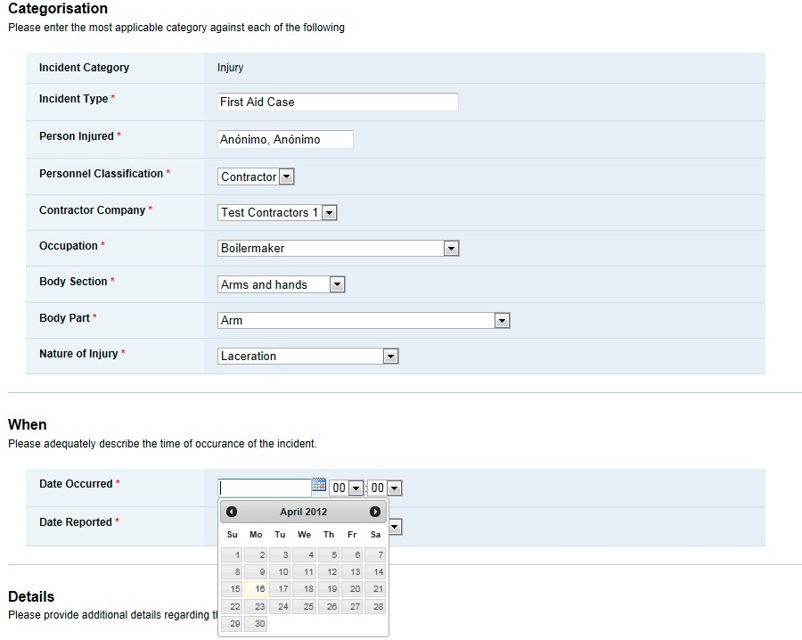

Slide 30
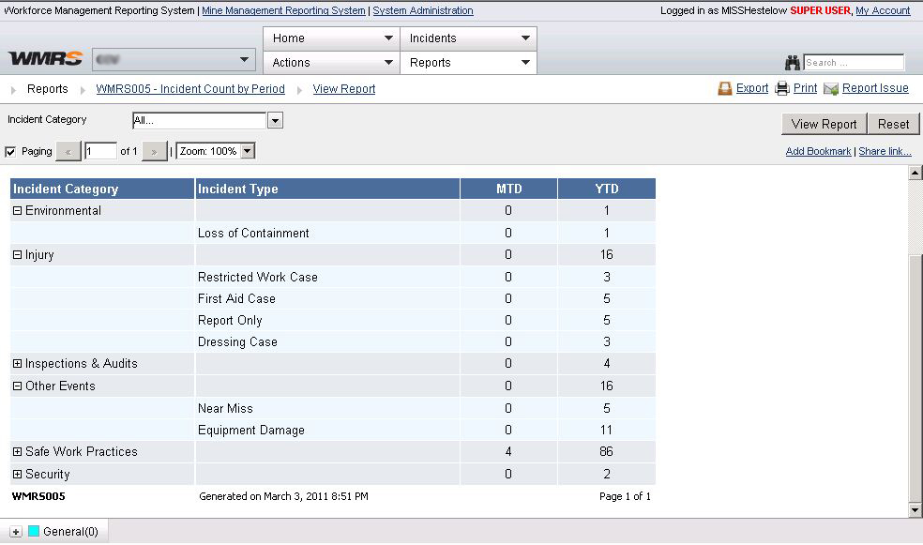

Slide 31
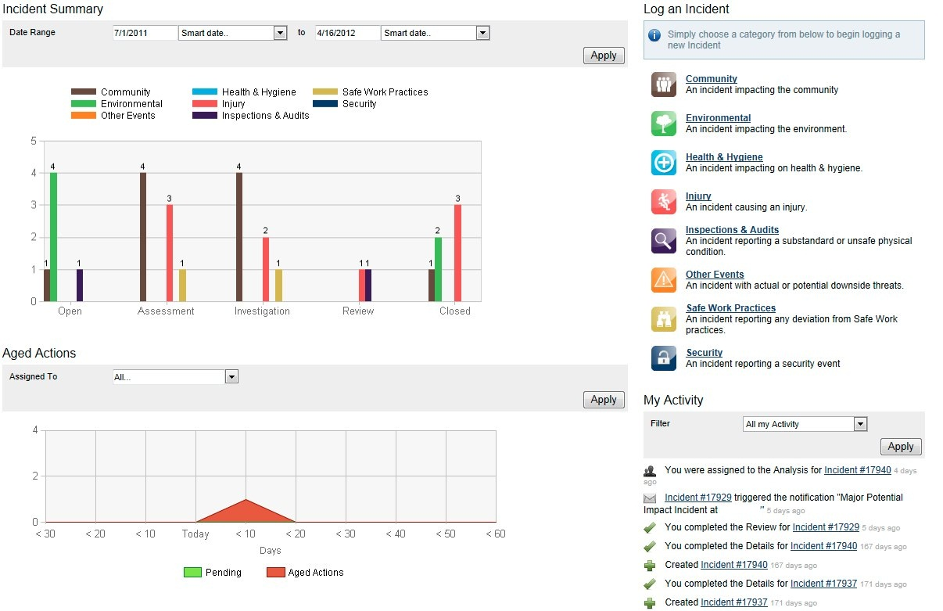

Slide 32
Thus we see, the WMRS, can provide:
Increased security of mine sites
Increased safety and incident prevention
Limits risks to both personnel and equipment
Scalable and can be used as a standard across many regions, languages and commodities
Low burden on local IT departments as the system is quick to set up and easy to maintain and support
Simplify the reporting of monthly or periodic safety
Assign actions to personnel (May be integrated with MMRS)
Automate the delivery of key reports
Instant notification of high impact incidents and risks

Slide 34
Current production better than HCL best ever When comparing India Resources Limited production figures with Hindustan Copper Limited (HCL) historic production data as they operated the Surda Mines for well over 4 decades, it becomes very clear that IRL through a combination of modern mining techniques & implementation of MIS has transcended the threshold of a start-up mining venture.
HCL’s highest production figures in a single year at an average production rate of 29, 174 tonne per month approx (1988-89 figures) has been decimated.
IRL in that sense has a firm foothold on the Surda Project and it shows in the rapidity with which all previous HCL production figures have been breached within a very short span.
1. | Hoisting to Surface | 1552 T on 30th January 2009
2. | Transportation to Mill | 2083 T 26th Oct 2008
3. | Loco Tramming | 1558 T 30th January 2009
4. | Backfilling | 1600 T 14th July 2008

Slide 35
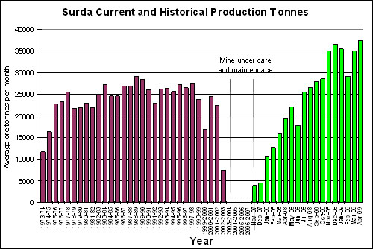

Slide 36
Backfill practices :
Historically a capacity of not more than 600 tons/day was achieved during HCL times. IRL has achieved a capacity increase to 1060 tons/day at the Surda Project.
Mine Planning, Geology and Surveying:
All data is entered into a computer and viewed in 3D via Surpac software.
Survey is carried out electronically with a Leica Total Station and can be viewed in 3D. These tools allow effective mine planning.

Slide 37
CONCLUSION:
Management Information System (MIS) has a great significance to
improve the Productivity Level and the overall Productivity levels of a mine.
MIS is therefore one of optimizing the output of a mine by connecting the operating sub-systems through the medium of information exchange.

Slide 38
.
THANK YOU

